Slide 1

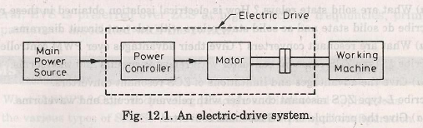

Slide 2
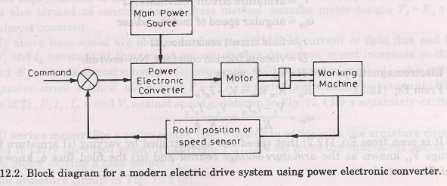

Slide 3
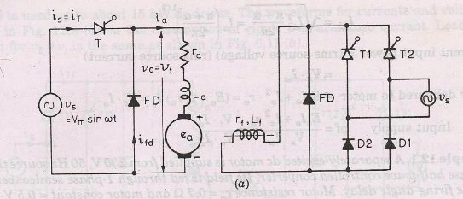


types
DC drives
AC drives

Slide 4
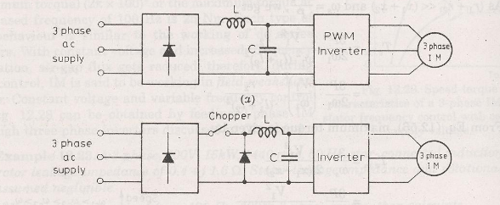
Sample drives

Slide 5
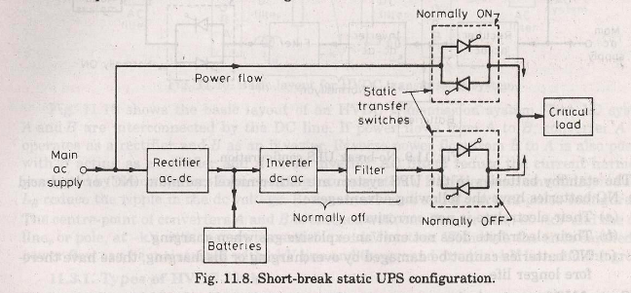
Un interruptible power supply (UPS) types short break UPS No break UPS

Slide 6
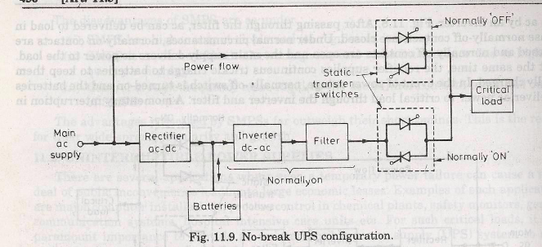

Slide 7

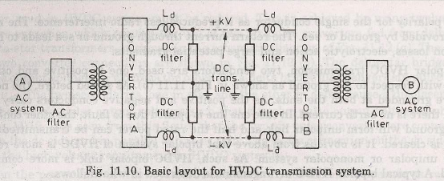

Slide 8
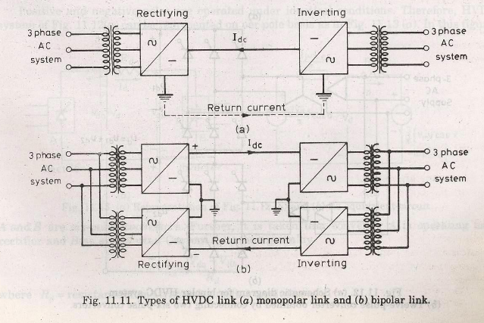

Slide 9
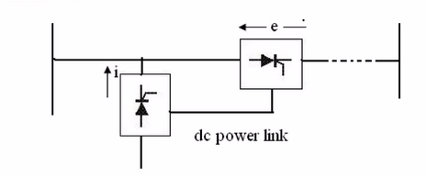
FACTS
Flexible AC Transmission Systems (FACTS) controllers use power electronics to enhance power transfer capacity, stability, and voltage control in high-voltage lines.
Types
shunt
series

Slide 10
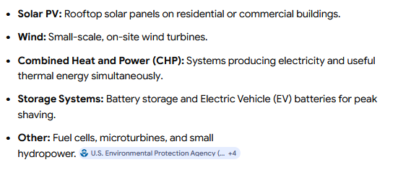
Distributed generation systems
Distributed power generation systems (DG) produce electricity directly at or near the consumer's location, rather than at centralized, distant power plants. T

Slide 11
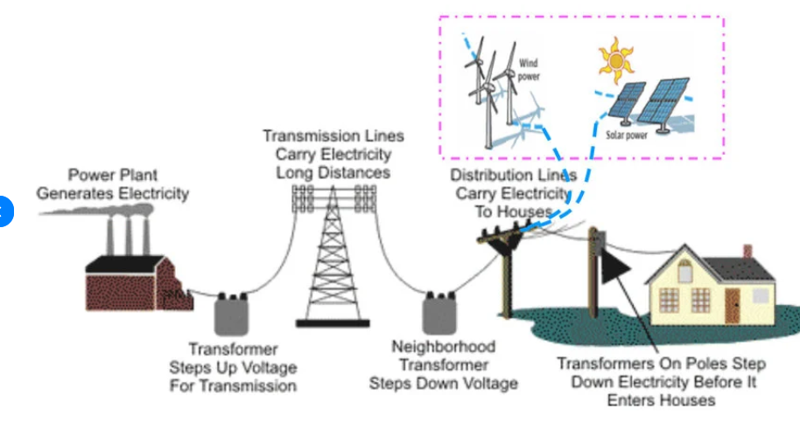

Slide 12
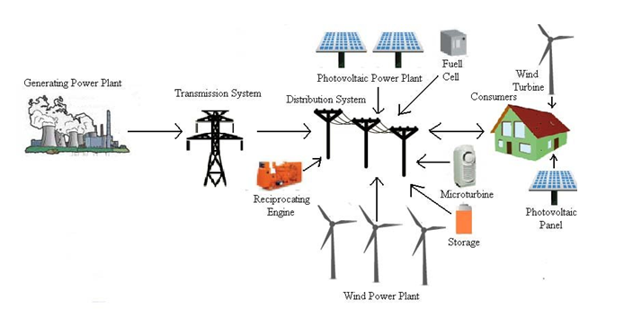

Slide 13
Custom Power Devices (CPDs) are power-electronic controllers used in distribution systems to improve power quality, mitigate harmonics, and correct voltage issues like sags and swells
DSTATCOM (shunt-connected for current issues), DVR (series-connected for voltage sags), and UPQC (combination of both)

